Slide 1
Chapter 1 Introduction
1.1 Probability theory
A key concept in the field of pattern recognition is that of uncertainty. It arises both through noise on measurements, as well as through the finite size of data sets. Probability theory provides a consistent framework for the quantification and manipulation of uncertainty and forms one of the central foundations for pattern recognition.
1.2. Decision theory
Combined with probability theory, it can allow us to make optimal decisions in situations involving uncertainty.
1.3. Information theory
A key measure in information theory is "entropy". Entropy quantifies the amount of uncertainty involved in the value of a random variable or the outcome of a random process.

Slide 2
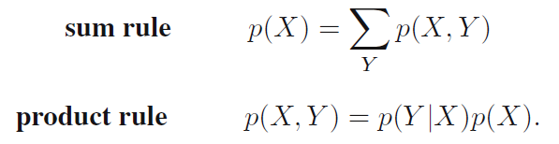
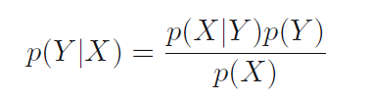

Chapter 1 Introduction
1.1 Probability theory
Two fundamental rules of probability theory
Bayes’ theorem
with

Slide 3


Chapter 1 Introduction
1.1 Probability theory
Bayesian probabilities:
Frequentist estimator: maximum likelihood (MLE or ML);
Bayesian estimator: MLE and maximum a posteriori (MAP);
This describes the uncertainty in model parameters.

Slide 4
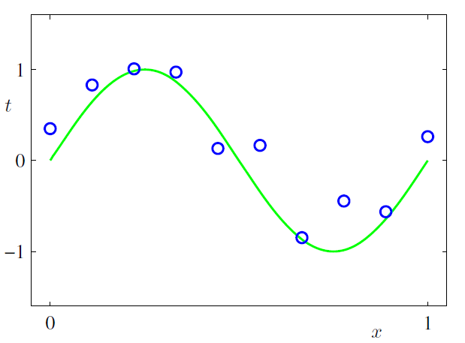



Chapter 1 Introduction
Example: Curve fitting problem
Input value
Training set:
Target value
Goal: Given a new $\hat{x}$, make the prediction of $\hat{t}$

Slide 5
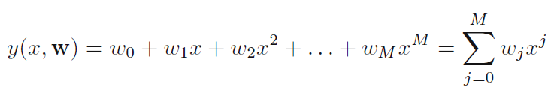
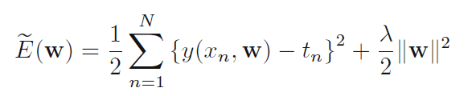
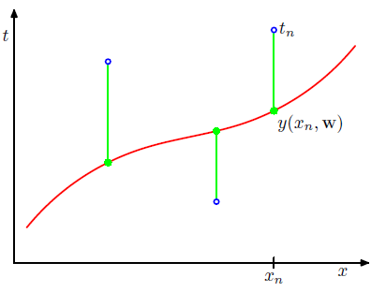
Chapter 1 Introduction
Solution 1: Error minimization
Minimize

Slide 6
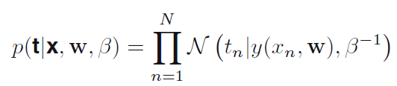
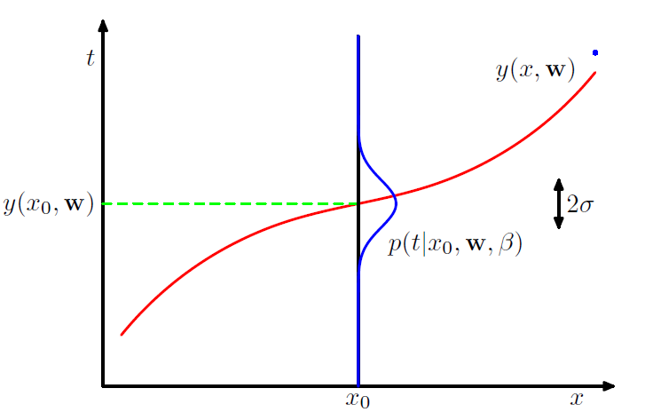




Chapter 1 Introduction
Solution 2: A probabilistic perspective
Assume that, given the value of x, the corresponding value of t has a Gaussian distribution with a mean equal to the value $y(x, w)$.
Maximize
A more Bayesian approach: introduce a prior distribution over the polynomial coefficients w.
Maximize
Minimize
Equivalent to the formal solution

Slide 7

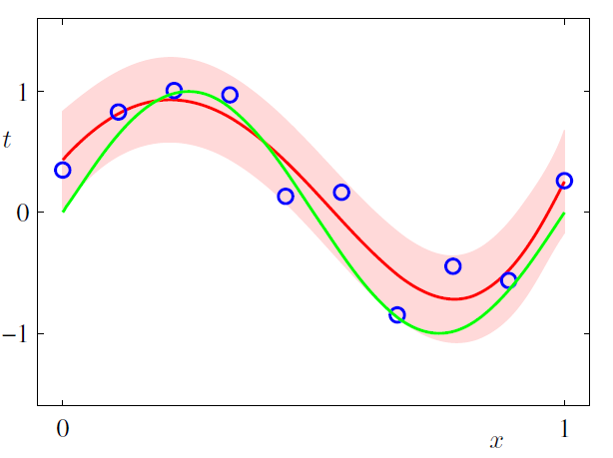

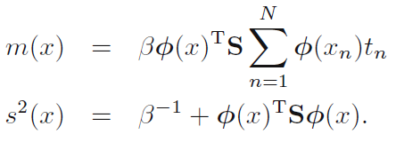
Chapter 1 Introduction
Solution 3: A Bayesian treatment
Assume that the parameters $α$and $β$are fixed and known in advance.
In a fully Bayesian approach, we should consistently apply the sum and product rules of probability, which requires that we integrate over all values of w.

Slide 8

Chapter 1 Introduction
1.2 Decision theory
The decision problem:
Given x, predict t according to a probabilistic model p(x, t)
Inference and decision
The inference stage in which we use training data to learn a model for posterior probabilities
the subsequent decision stage in which we use these posterior probabilities to make optimal class assignments.
3 kinds of decision approaches:
Generative models
determine the class-conditional densities
infer the prior class probabilities
Use Bayes’ theorem to find the posterior class probabilities
Discriminative models
determine the posterior class probabilities
use decision theory to assign each new x to one of the classes.
Find a function f(x) In this case, probabilities play no role. A single learning problem.

Slide 9

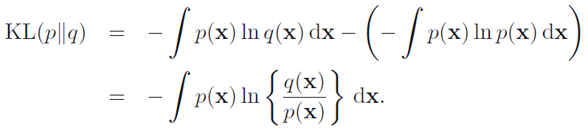
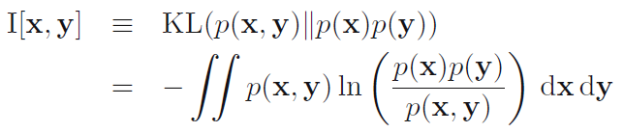


Chapter 1 Introduction
1.3 Information theory
Entropy, the average amount of information needed to specify the state of a random variable
Relative entropy
Unknown distribution $p(x)$
Approximating distribution $q(x)$
Mutual information
A measure of the mutual dependence between the two variables.

Slide 10
Chapter 2 Probability Distributions
2.1 The beta distribution
2.2 The Dirichlet distribution
2.3 The Gaussian Distribution
2.4 The Exponential Family
2.5 Nonparametric Methods
Kernel density estimators
Nearest-neighbour methods

